Slide 1
30 Years’ of Focused Leadership in Portable ULTRASONIC TESTING EQUIPMENT

Slide 2
Modsonic with a remarkable portfolio of innovative Ultrasonic Flaw Detectors, with commitment to leading-edge technology and user-friendliness is introducing Arjun Series India’s First Palmtop, Ultralight Ultrasonic Flaw Detectors

Slide 3
The Future…

Slide 4
Presenting Power of Arjun30 India’s First Palmtop, Ultralight Ultrasonic Flaw detector with Built in UT Data Recording and Colour Flaw Plotting

Slide 5
Power of Convenience + Power of Performance + Power of Affordability = Power of Arjun30

Slide 6
Power of Convenience

Slide 7
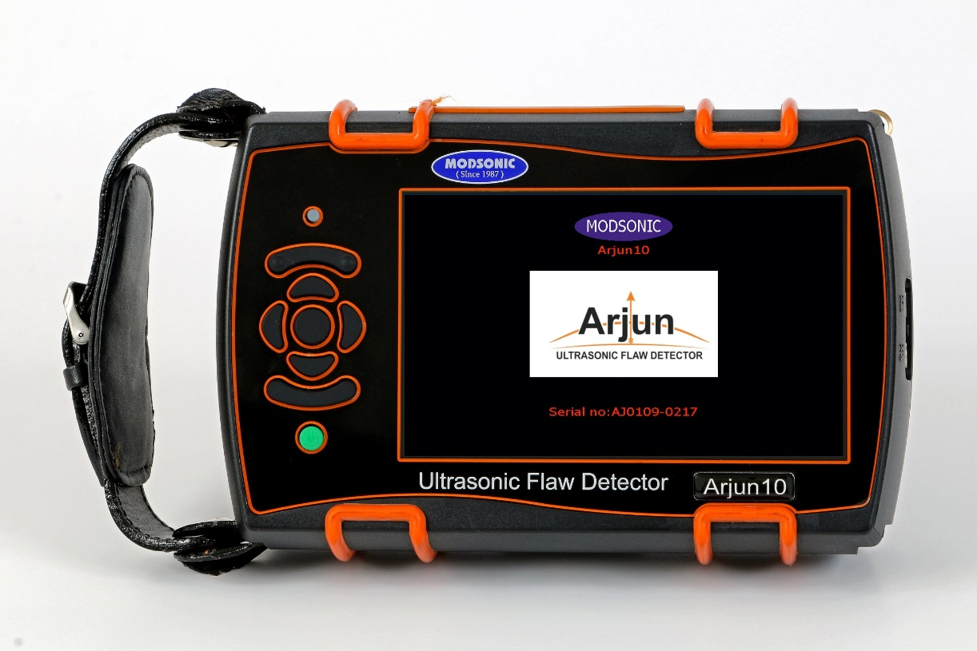
Arjun Series
Power of Convenience
Easy and simple Menu Navigation
Weighs Less then 800 Gms
Camcorder style Leather Wrist strap for Secure and Comfortable Grip
8+ Hours of Battery Life
Single Hand Operation
Palmtop

Slide 8
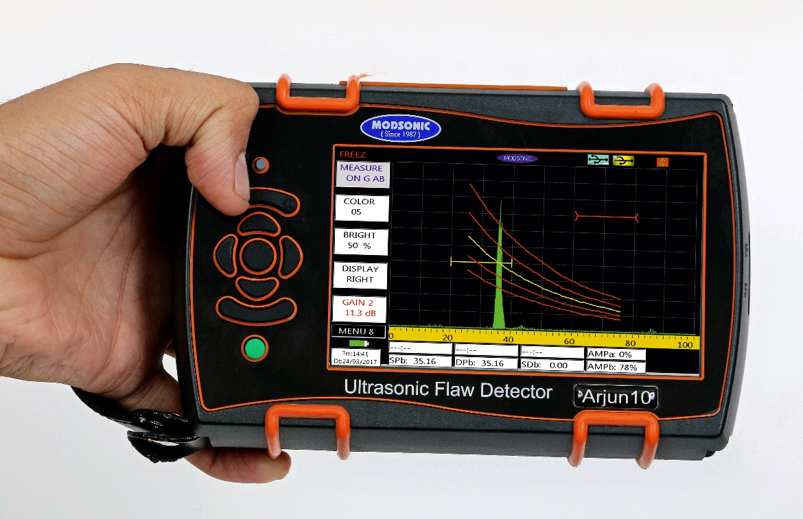
Power of Convenience
Weighs only 800 Grams with grip oriented weight distribution.
The hardware and software of Arjun30 maximizes the efficiency of Ultrasonic testing with single hand operation freeing up user’s other hand to manoeuvre the probe

Slide 9
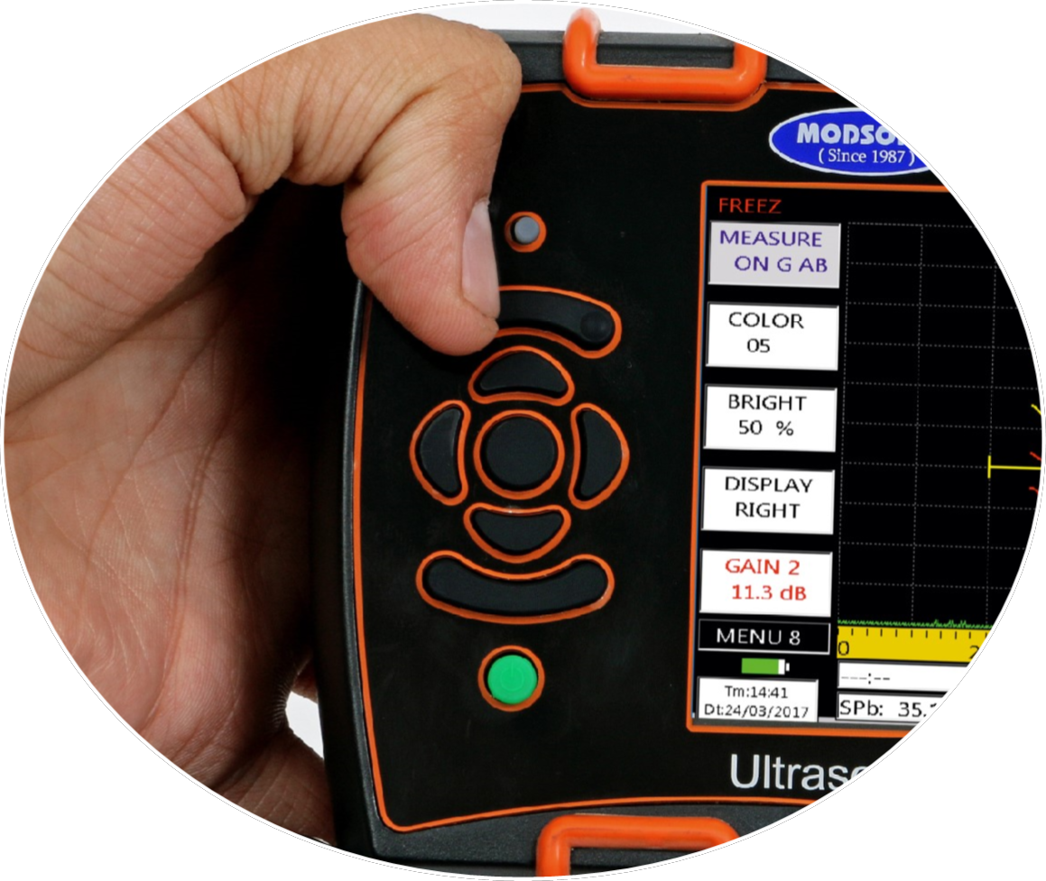
Power of Convenience
Only few keys for operation
Simple button orientation for easy menu navigation.

Slide 10
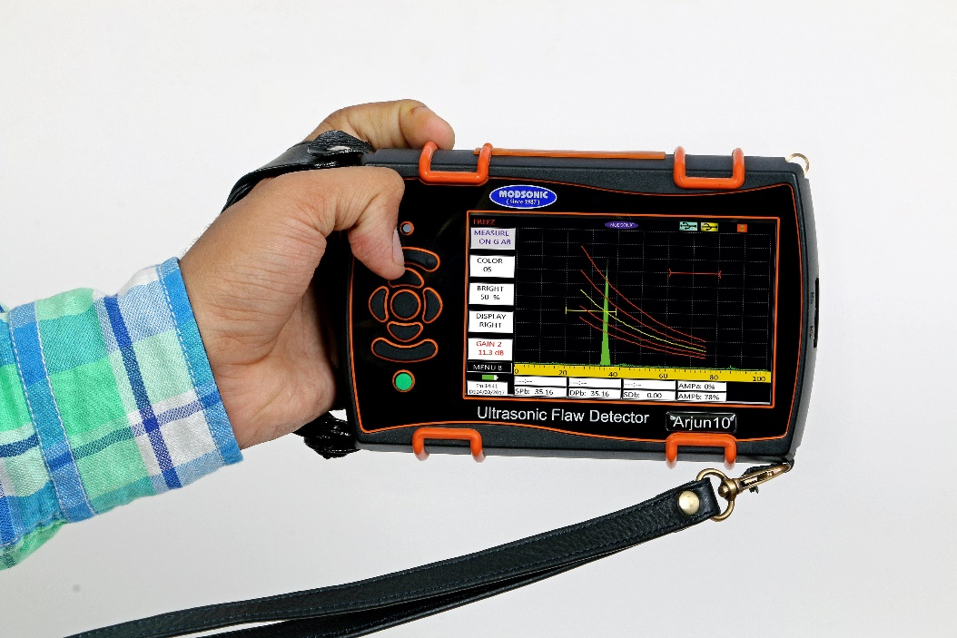
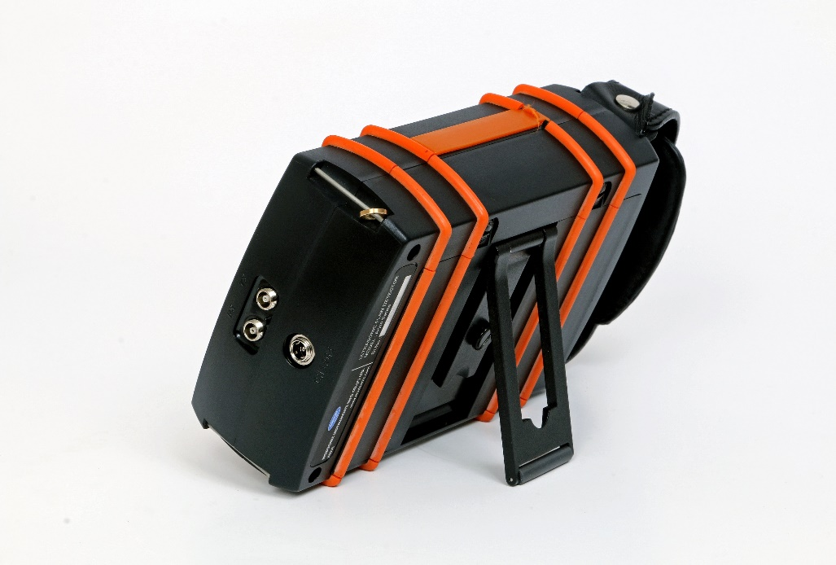
Power of Convenience
To avoid accidental fall Neck strap is provided for extra protection.
Hinged stand to hold the instrument stable on any surface.

Slide 11
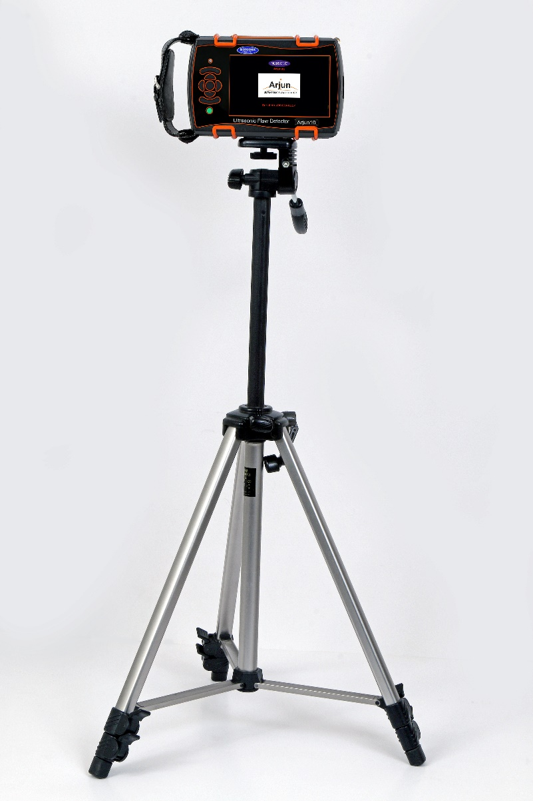
Power of Convenience
Arjun can be mounted on Tripod for hands free operation.
Very convenient on shop floor.

Slide 12
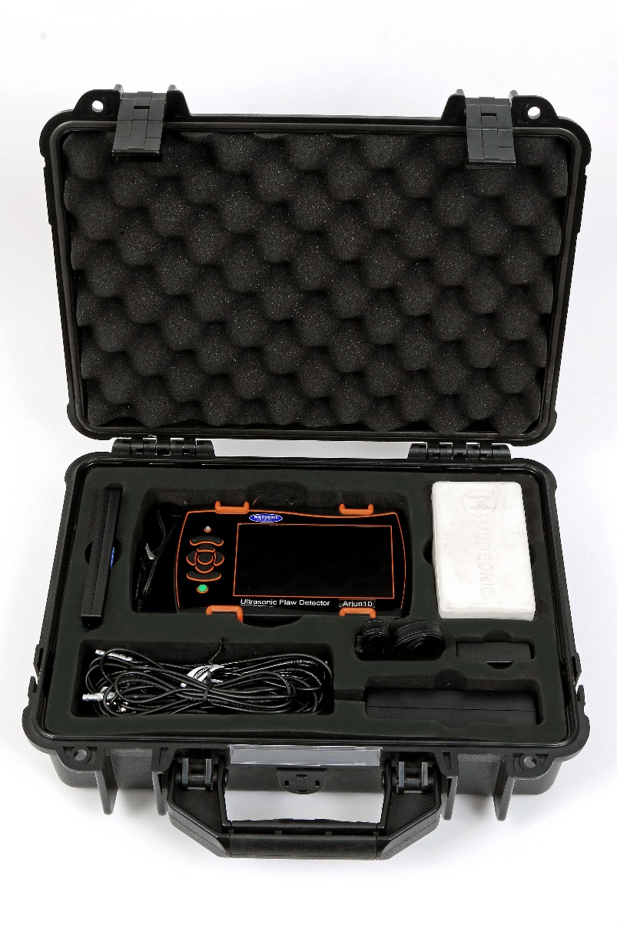
Power of Convenience
Pelican type carrying case for more protection and easy handling of the instrument with extra room for Probe box, cables and extra battery pack.

Slide 13
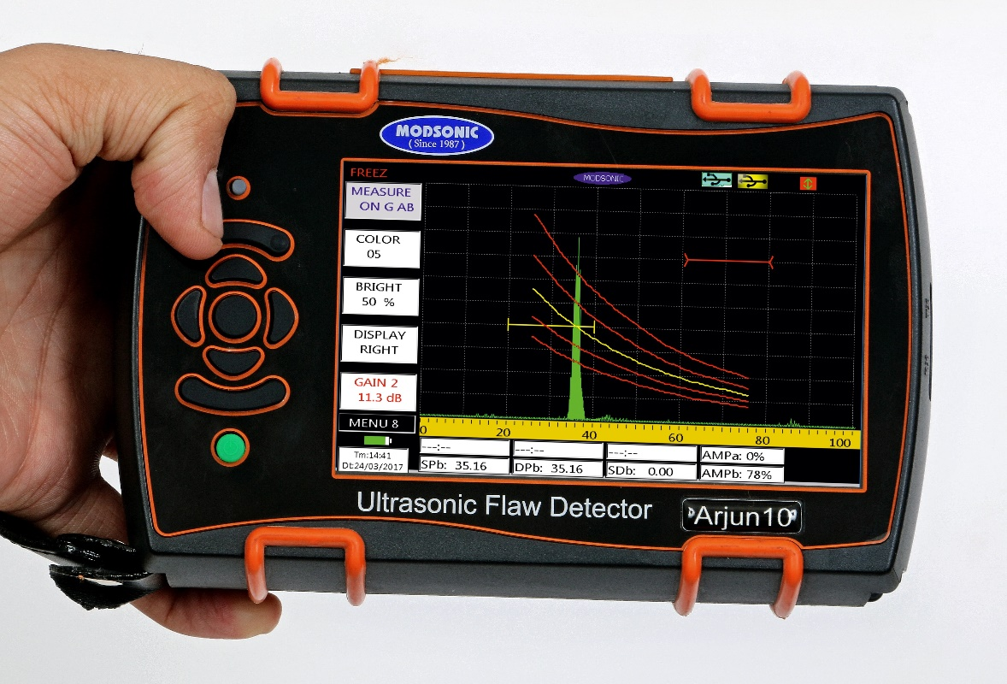
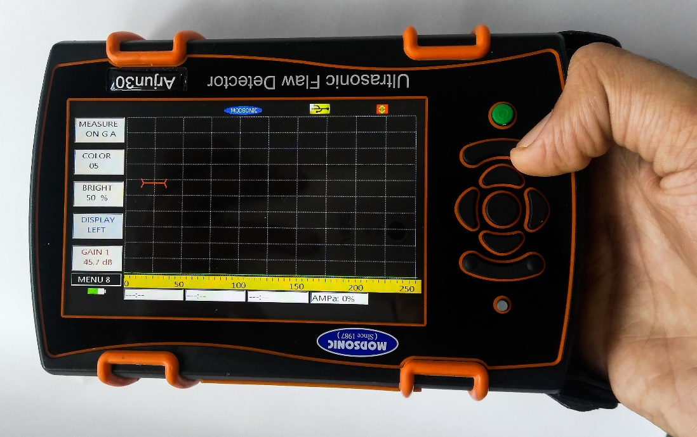
Power of Convenience
Display Rotation
Display Rotation feature makes it more convenient for Left hander as well as Right hander user.

Slide 14
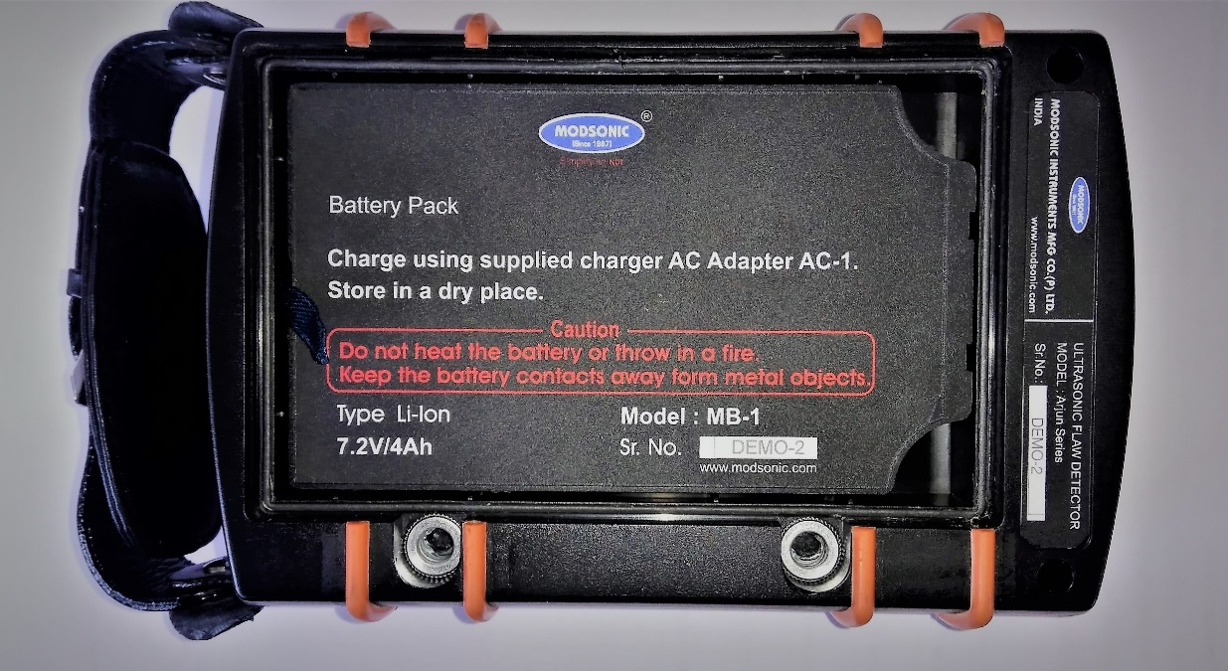
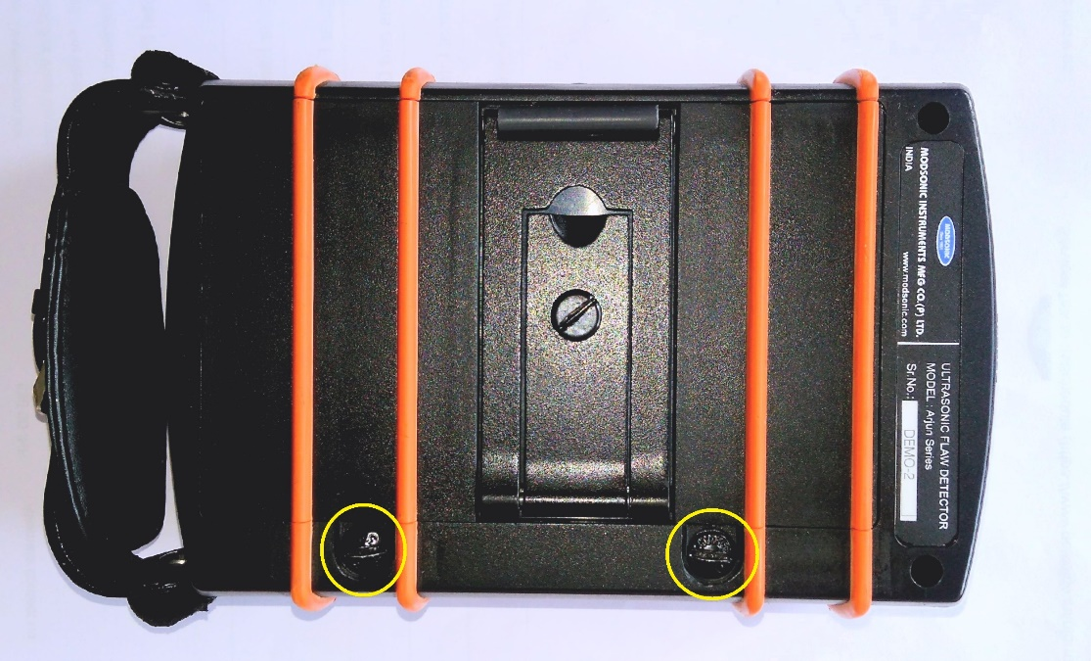
Power of Convenience
Quick Release Fasteners
Battery in the Compartment
Battery and Charging
World class high capacity Li-Ion battery which gives 8 hours of continuous operation with full charge
Battery Compartment has ‘quick release fasteners’ for easy and quick replacement of battery.

Slide 15
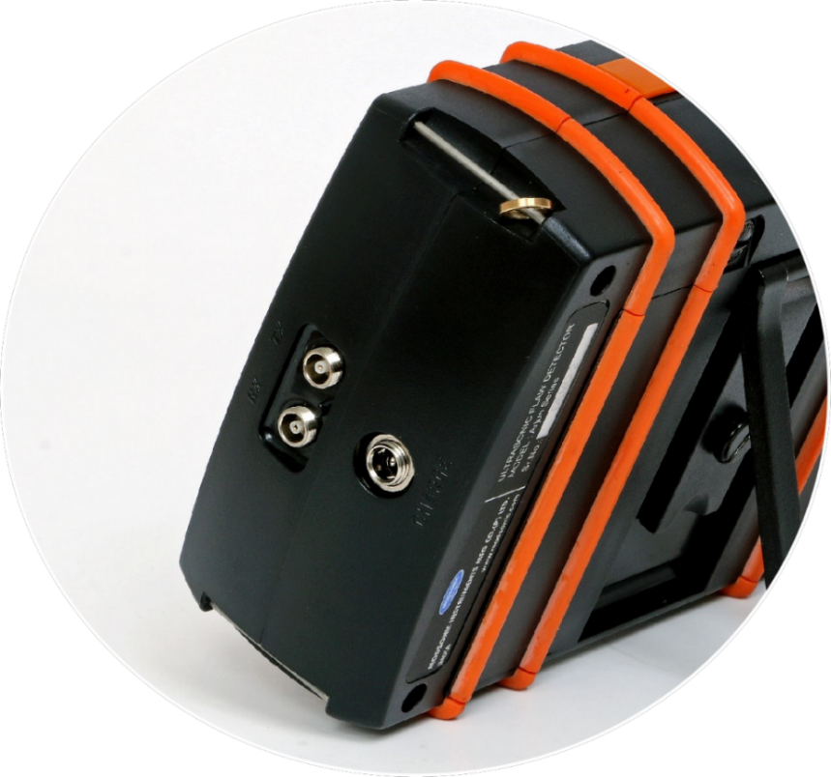
Power of Convenience
Charging connector
Lemo Size 00 Connectors
Connectors
Lemo Size 00 or Mini Lemo connectors.
Charging connector with special charging circuit is built-in inside Arjun. Plug in the AC adaptor provided to charge the battery within four hours.

Slide 16
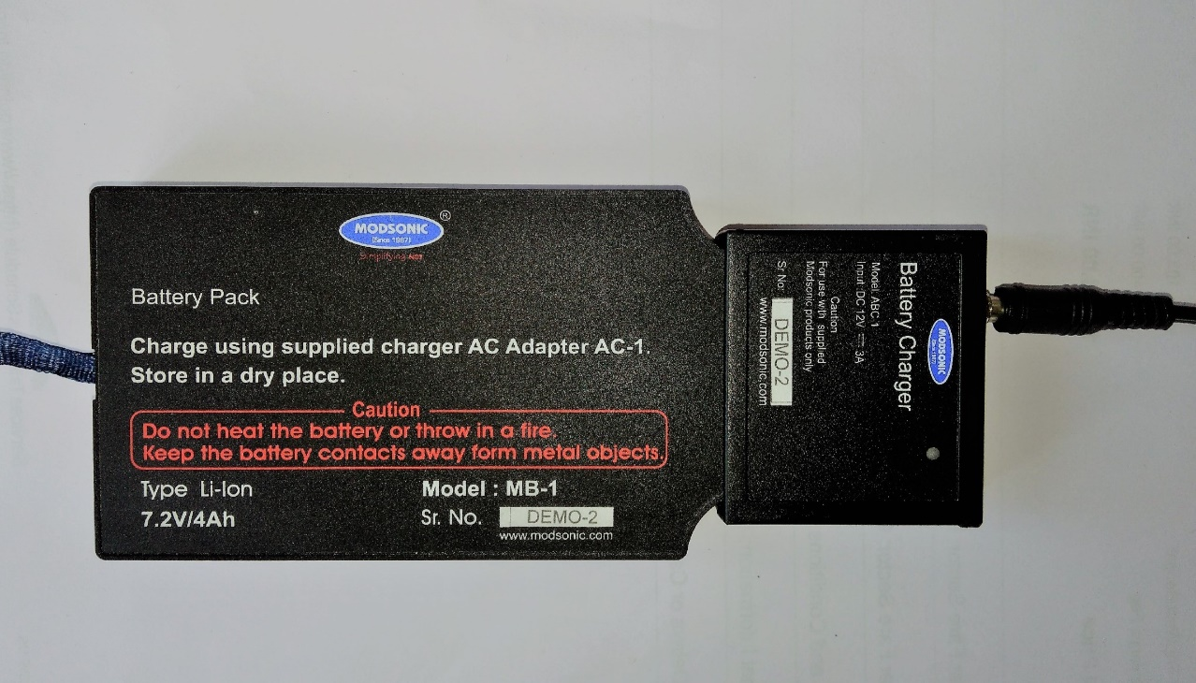
Power of Convenience
Battery can be charged inside the machine as well as EXTERNALLY without engaging the machine by connecting a Charging Dock Station provided along with the machine. So with the spare battery you can have round the clock testing.

Slide 17
Power of Convenience
IP Sealing
Mating joints are gasketed for protection against water splash and dust.

Slide 18
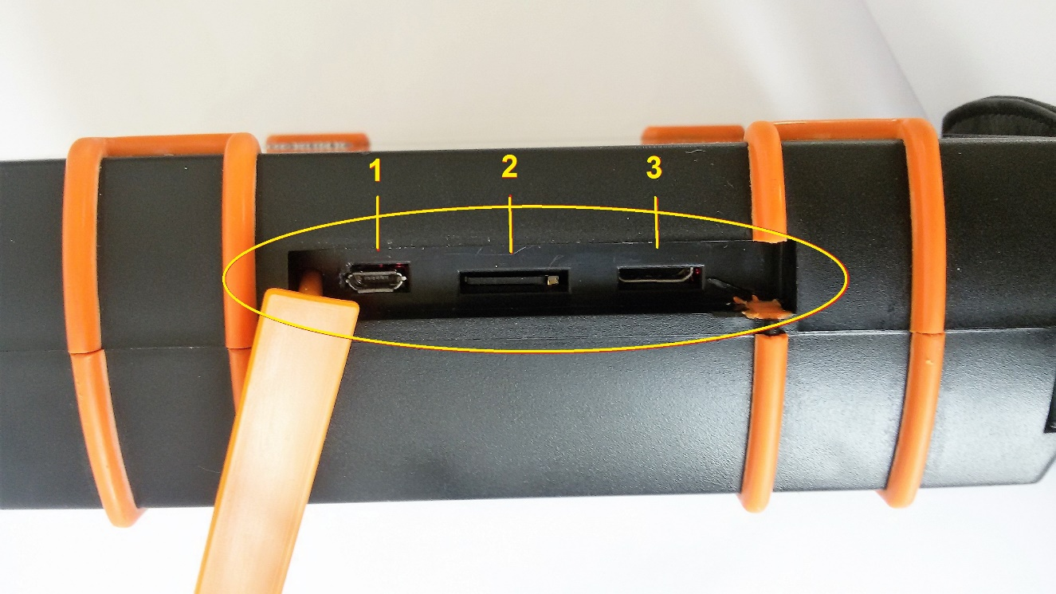
1. Micro USB slot for data transfer facility 2. Micro SD card Slot for data storage, up-to 32 GB SD card supported 3. I/O port for Single Axis Encoder input and TTL output for external monitor alarm
Power of Convenience
Connectivity and Storage

Slide 19
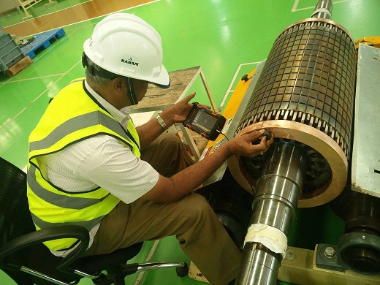
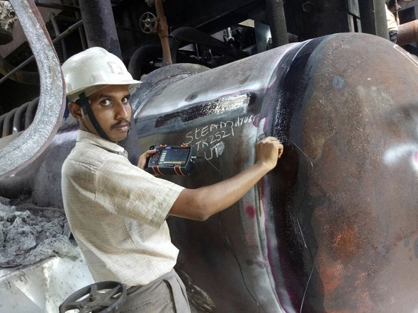
Best for High Portability Inspection Applications
Power of Convenience
Arjun On-Site.
Most Convenient in the field and shop floor.

Slide 20
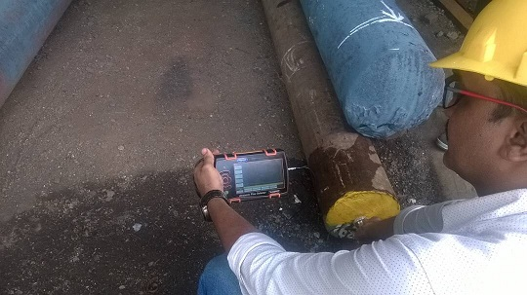
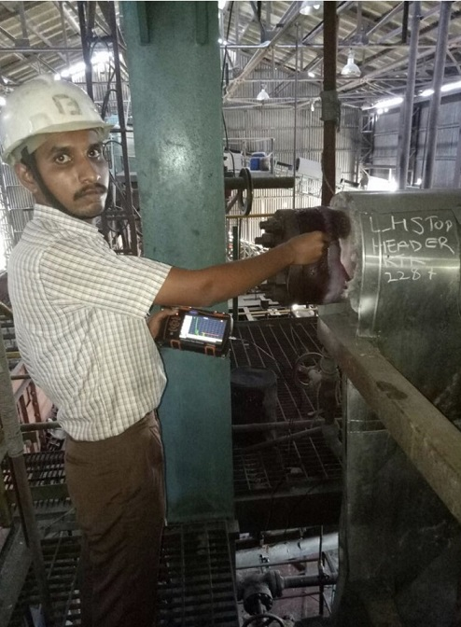
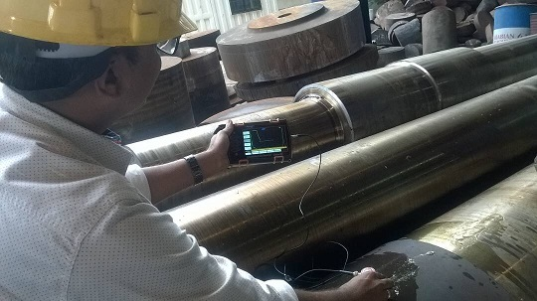
Power of Convenience

Slide 21
Power of Performance

Slide 22
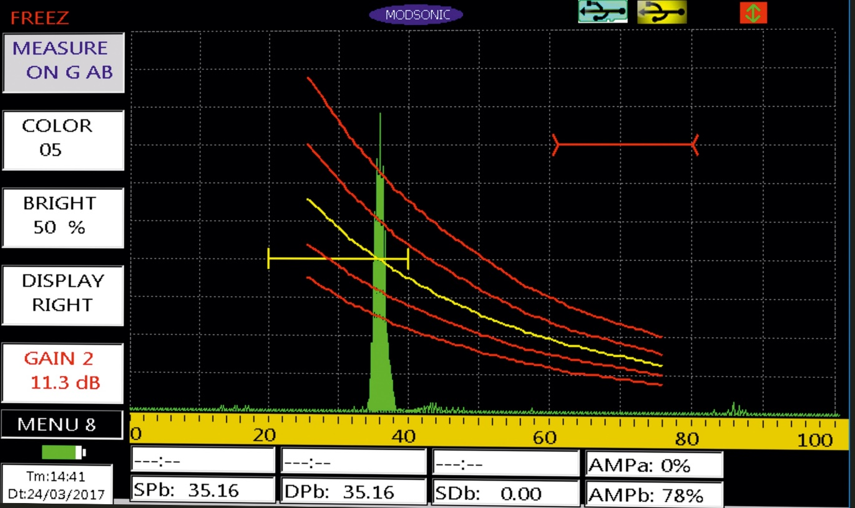
Power of Performance
Display Resolution
High Resolution (800 × 480 Pixels) WVGA clear, bright display for better visibility in any lighting conditions.

Slide 23
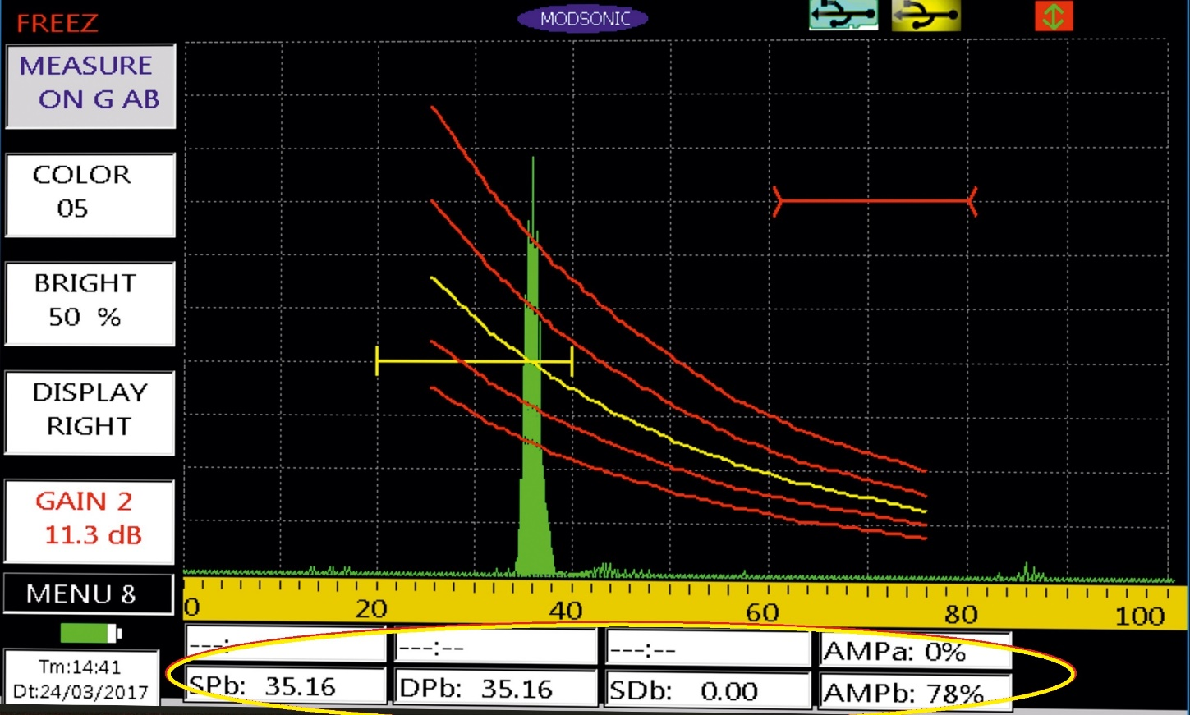
Simultaneous Display of Measurement Values
Power of Performance
Simultaneous display of measurement values helps the operator for quick interpretation of the signals

Slide 24
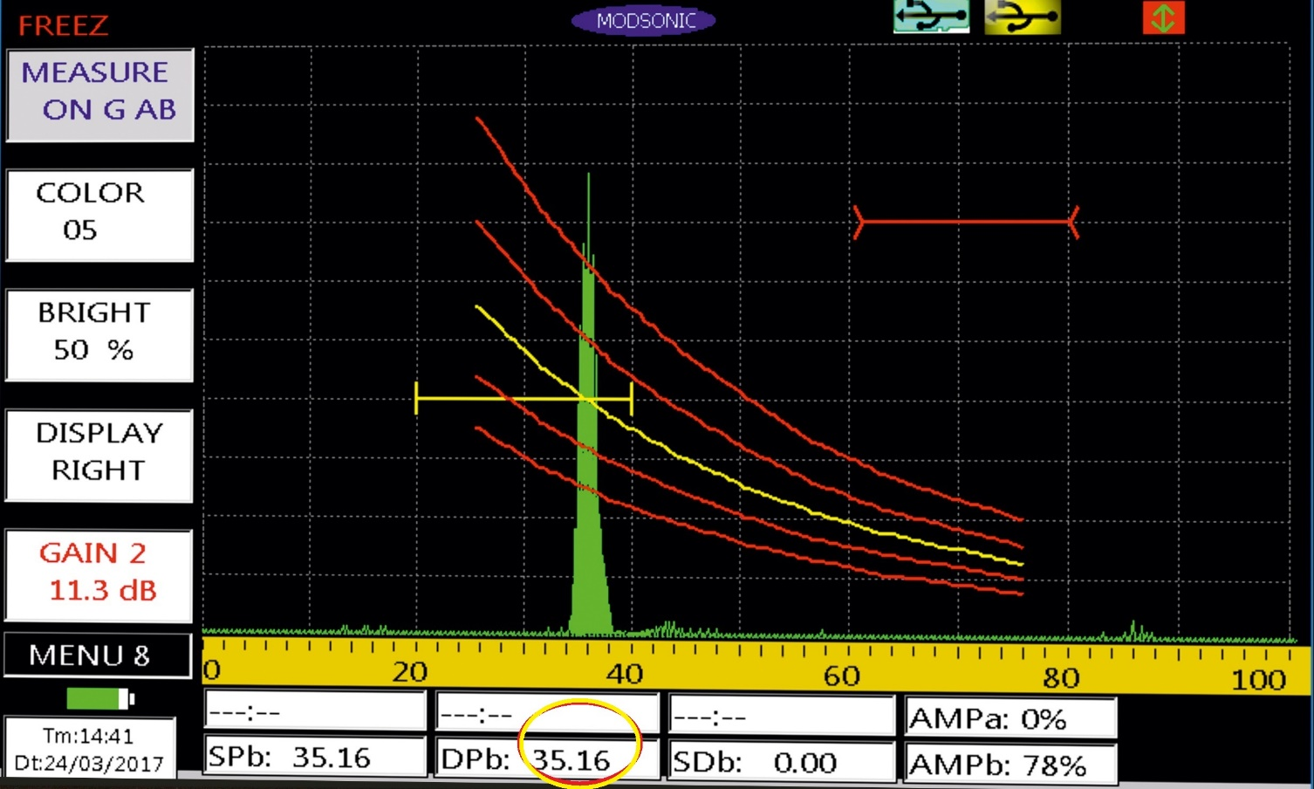
Power of Performance
Measurement Resolution
Measurement resolution of 0.01mm for better accuracy.

Slide 25
DAC/TCG
Power of Performance
Auto Plotting standard dynamic DAC/TCG for easy defect evaluation.
Multiple curves with user selectable dB intervals (1dB to 14dB). Any of the curves can be selected as flaw monitor gate.

Slide 26
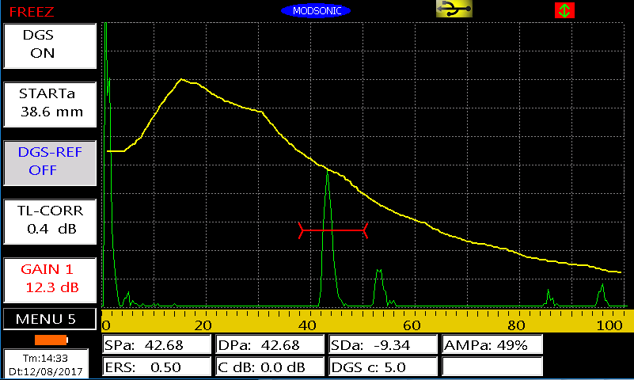
DGS/AVG
Power of Performance
On-Board DGS/AVG for defect sizing.

Slide 27
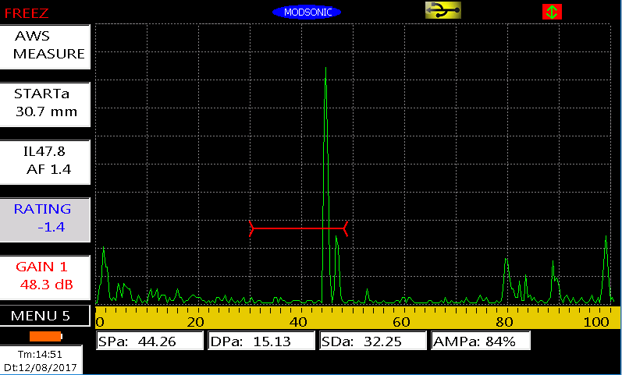
AWS D1.1
Power of Performance
Built in Software for AWS which provides dynamic reflector indication ratings for various AWS Weld inspections
Allows efficient inspections by eliminating manual calculations

Slide 28
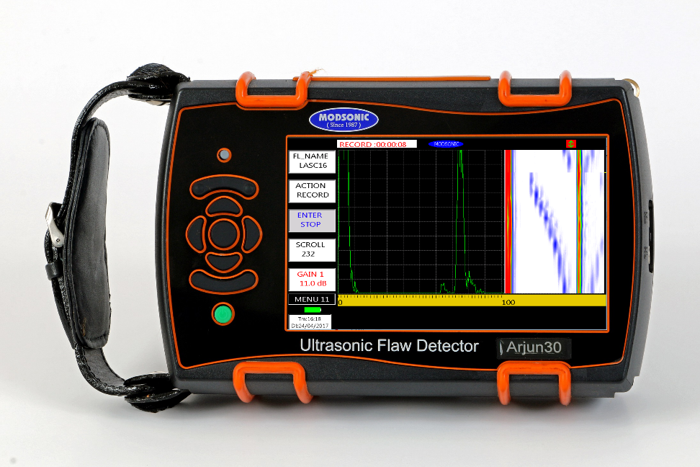
For the first time- Evidence and Documentation
Power of Performance
It comes with the Continuous UT Data Recording facility with Colour Flaw Plotting.
Up-to 100 Hours of UT Data Recording can be stored on 8GB Micro SD card.
Best for Evidence based testing with Non-Tamperable Date/Time format in recording and also simultaneous analysis of B-Scan and A-Scan in Arjun30.

Slide 29
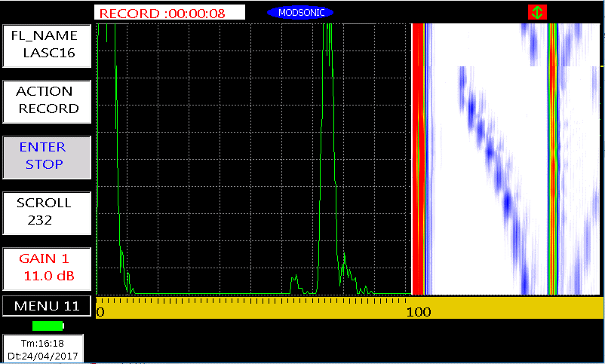
Recording Indication along with Non-Tamperable Date and Time Stamp for full proof Evidence
Power of Performance
Recording Indication
Non-Tamperable Date and Time Stamp

Slide 30
A-Scan and B-Scan recording from a Phased Array block in Arjun30
Power of Performance

Slide 31
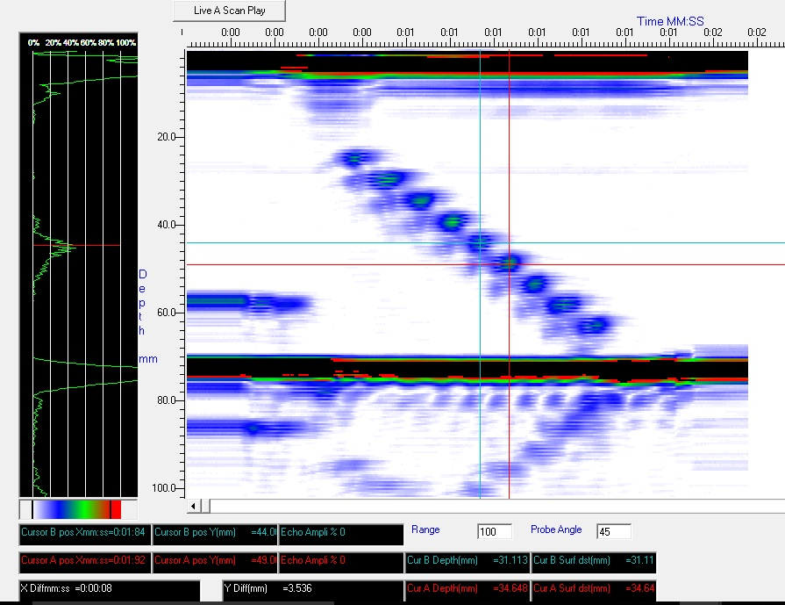
B-Scan and A-Scan analysis of recorded file on PC in ArjnSoft Software.
Power of Performance

Slide 32
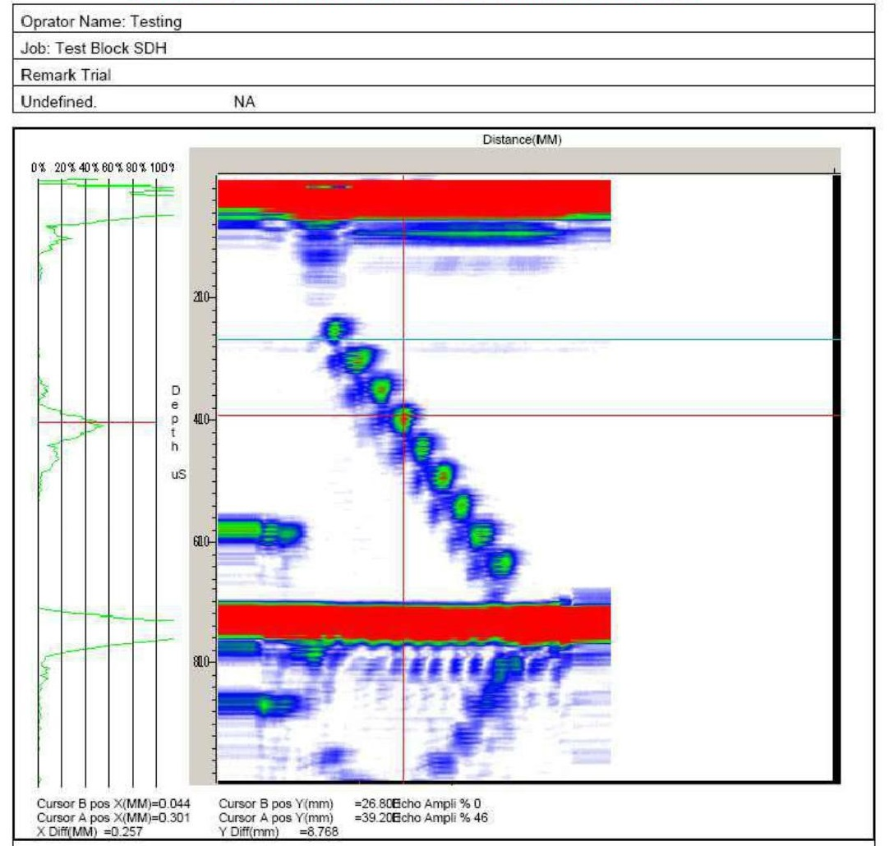
Report in PDF or Word format can be generated, with all the essential information like operator details, Job Details, Defect details.
Power of Performance
Sample of Generated B-Scan Report file
Archival: Reporting and Printing

Slide 33
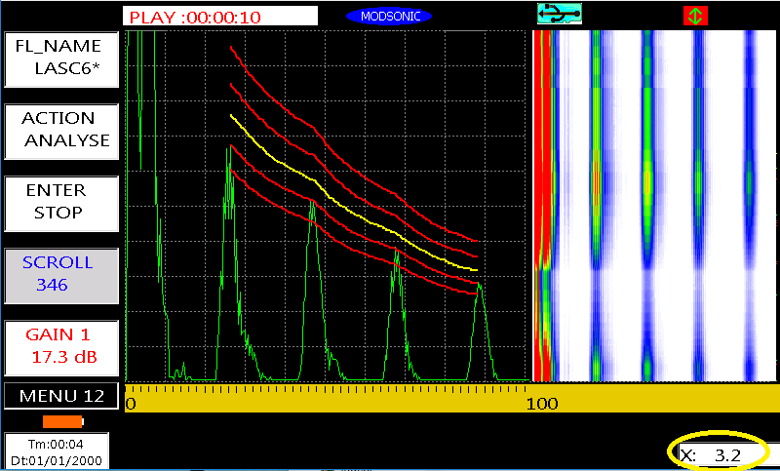
Single axis Encoder Input for Real time Probe positioning in mm/Inches.
Power of Performance
Encoder Value
Encoder Input

Slide 34
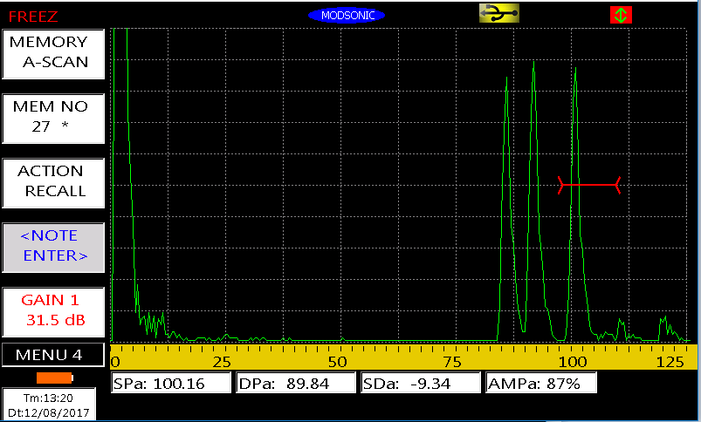
Normal Probe: 4MHz, 10MM Diameter on V1 Block Resolution Notch.
Power of Performance
Far Surface Resolution

Slide 35
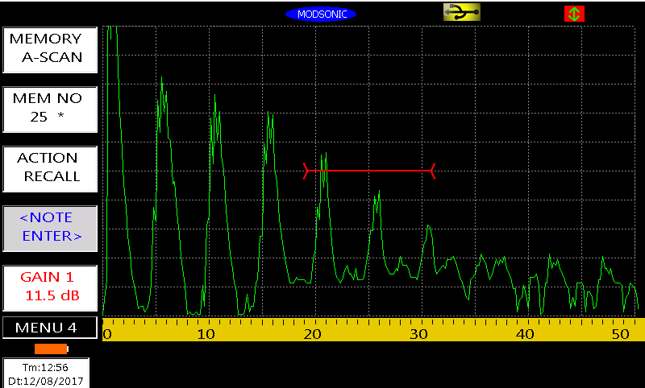
Normal Probe: 4MHz, Normal Probe. - Reflection from 5mm Step from VW Block.
Power of Performance
Dead Zone/NSR in Normal Probe

Slide 36
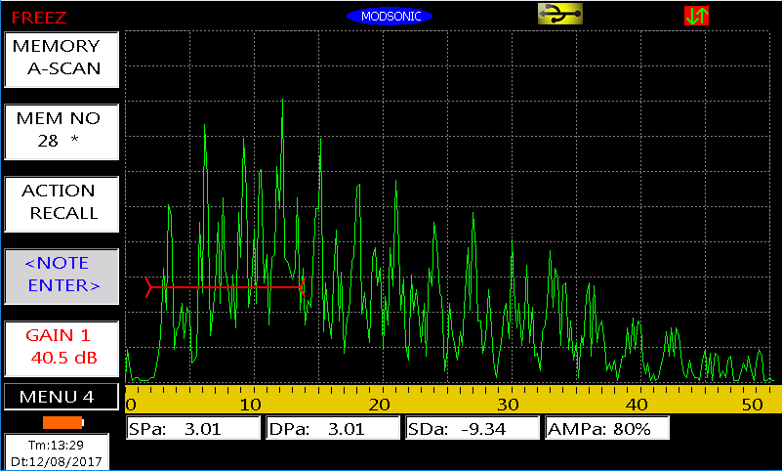
Twin Crystal Probe: 4MHz, Dual Crystal Probe. - Reflection from 3mm Step from VW Block.
Power of Performance
Dead Zone/NSR in TR Probe

Slide 37
Angle Probe: 4MHz, 70 Degree Angle Probe. - Reflection from 1.5mm SDH from V1 Block
Power of Performance
Dead Zone/NSR in Angle Probe

Slide 38
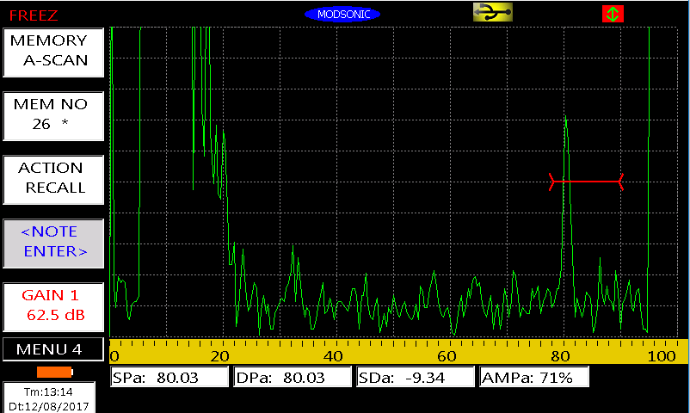
Normal Probe: 4MHz, Normal Probe. - Reflection From 1/64” Reflector from the ASTM Standard block
Power of Performance
Sensitivity

Slide 39
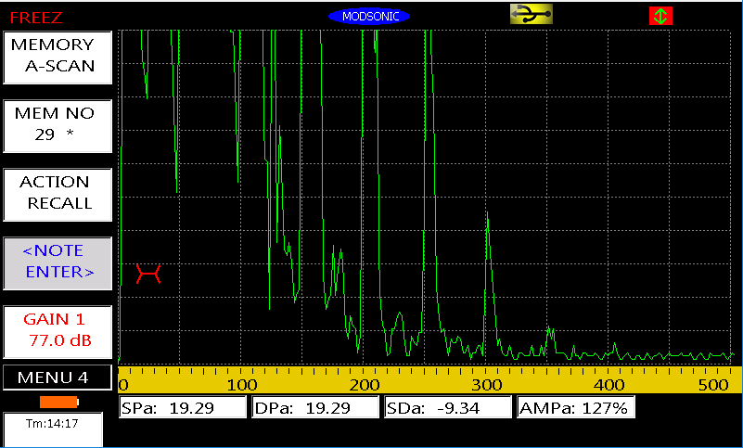
Normal Probe: 2MHz, 24MM Diameter on V1 Block Perspex insert. - Total No of back wall reflections are 6 full and 7th about 40% FSH with noise level about 10%
Power of Performance
Penetration Power

Slide 40
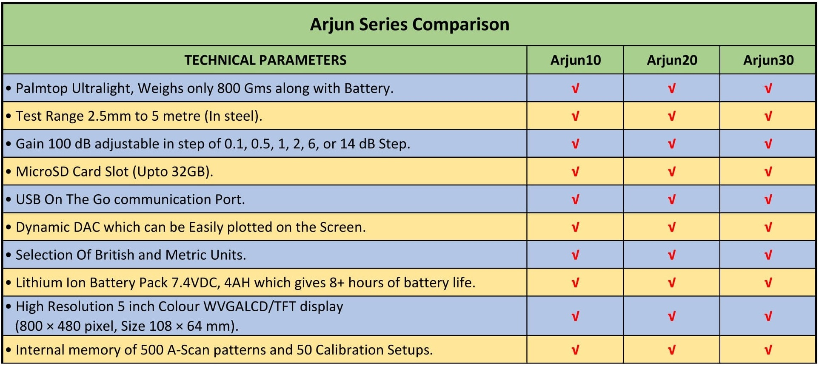
Comparison Matrix of Arjun Series Part I

Slide 41
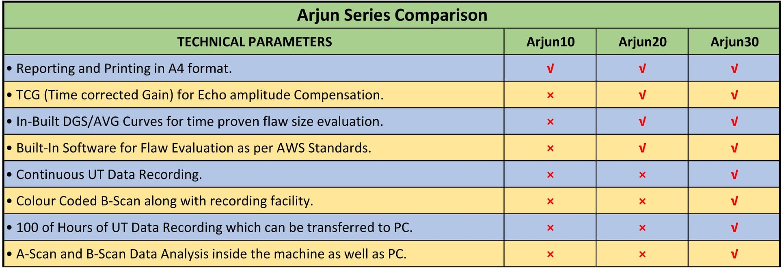
Comparison Matrix of Arjun Series Part II

Slide 42
Power of Affordability

Slide 43
Power of Affordability
Arjun10, Arjun20 and Arjun30 are available at MOST AFFORDABLE PRICES.
Taxes are reduced from 30% to 18% .
Input credit against GST is possible for NDT Service Providers.
(Consult your Chartered Accountant)

Slide 44
Power of Affordability
Trade-In your old Modsonic Digital Ultrasonic Flaw Detector with Arjun Series
AT INCREDIBLE PRICE

Slide 45
Product Overview

Slide 46
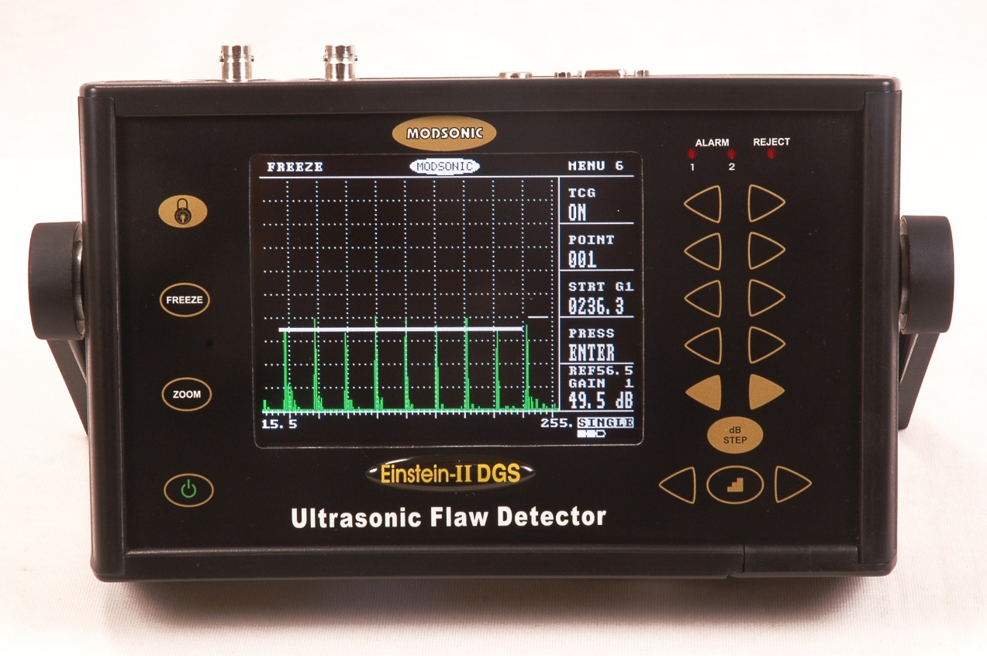
Our Portfolio of other Ultrasonic Testing Equipment :
Most popular machine worldwide.
More than 5000 units sold
Featured with Dynamic DAC/TCG, DGS, AWS
Einstein II DGS

Slide 47
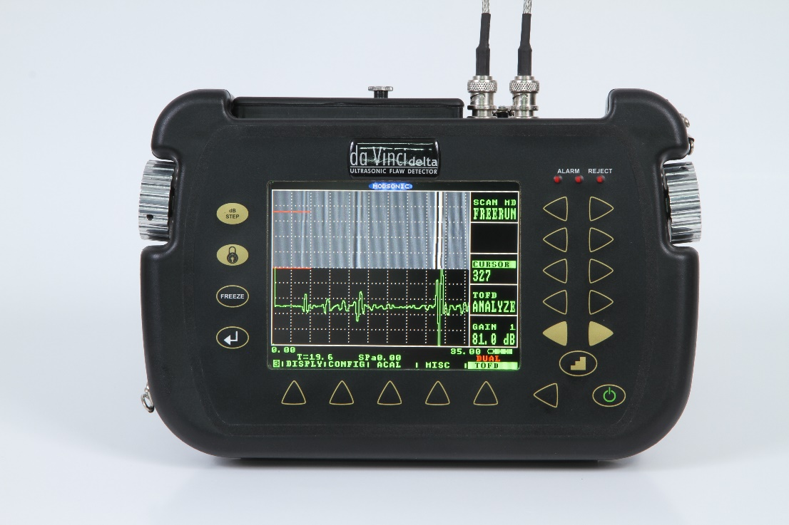
Our Portfolio of other Ultrasonic Testing Equipment :
IMAGING Ultrasonic Flaw detector
Featured with B-Scan, C-Scan and TOFD for High performance Flaw detection.
For specialized application like Corrosion mapping and Oxide Scale Thickness Measurement.
da Vinci delta

Slide 48
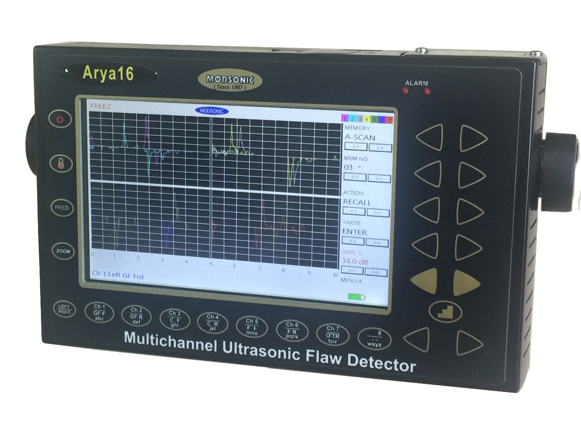
Our Portfolio of other Ultrasonic Testing Equipment :
Multi Channel Ultrasonic Flaw detector available in 8 or 16 Channels with different coloured A-Scan traces.
Ideal for integrators of Automatic Ultrasonic Testing Systems.
7 Inch display and weighs only 2 Kgs.
Arya Series

Slide 49
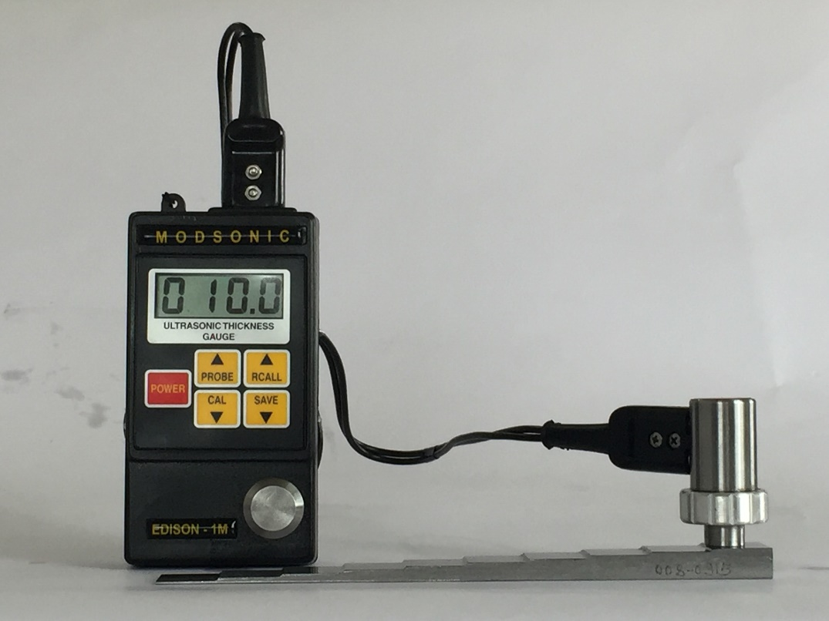
Our Portfolio of other Ultrasonic Testing Equipment :
Ultrasonic Thickness Gauges and Velocity Meters.
Different variants are available to fulfil various applications.
Supplied more than 6000 Units worldwide.
Edison Series

Slide 50
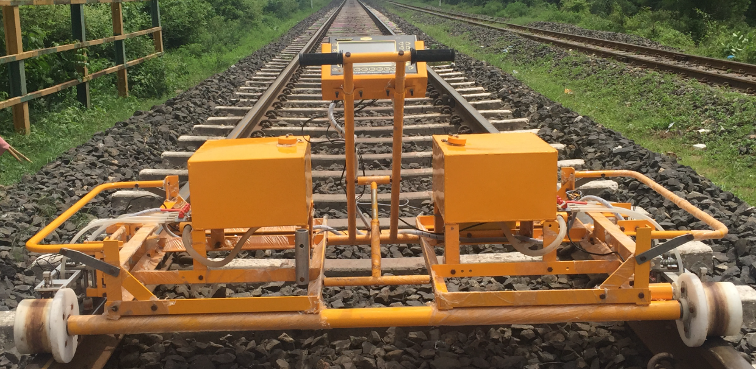
Our Portfolio of other Ultrasonic Testing Equipment :
RDSO approved Railway Products:
1) Axle Tester
2) Rail Weld Tester
3) Rail Testers
Sold More then 1000 Units to Indian Railways and also exported.
Railway Products

Slide 51
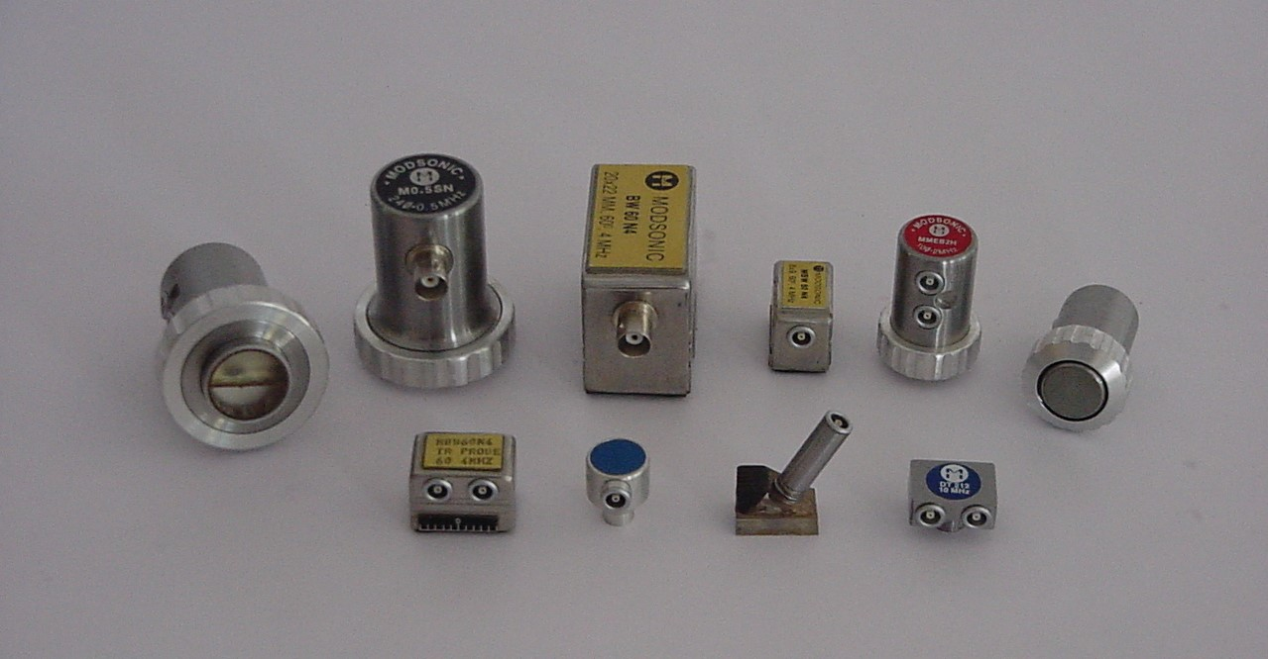
Our Portfolio of other Ultrasonic Testing Equipment :
Wide range of High Quality Standard and customized probes with test certificates
Ultrasonic Probes

Slide 52
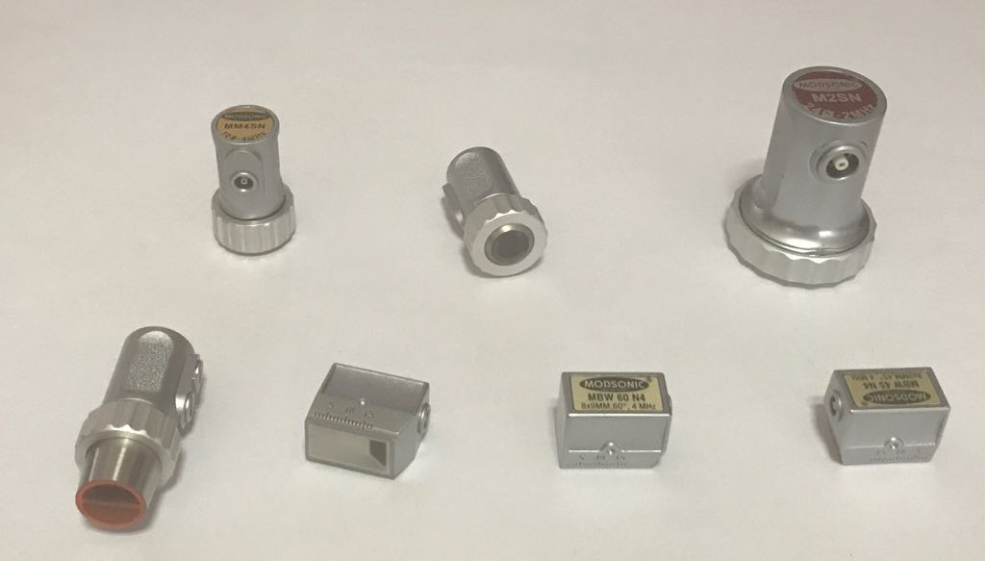
Our Portfolio of other Ultrasonic Testing Equipment :
We have Introduced Pro Series Probes with improved performance.
Pro Series Ultrasonic Probes

Slide 53
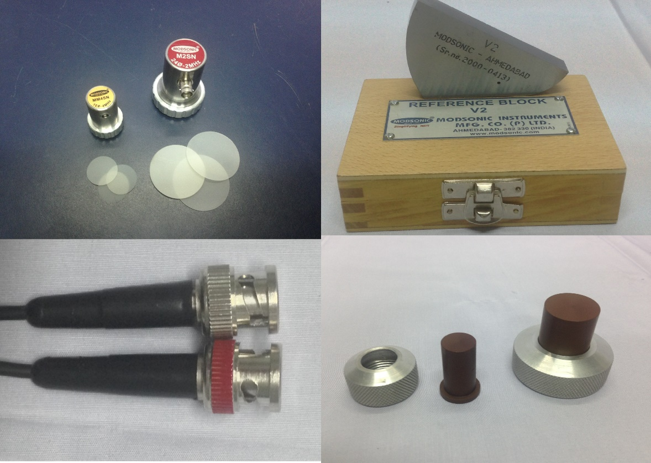
Our Portfolio of other Ultrasonic Testing Equipment :
We have wide range of allied accessories supporting our Flaw detectors and Thickness gauges.
Probe Cables, Standard Reference and calibration blocks, Special Probe wedges and attachments, couplants.
Allied Accessories

Slide 54
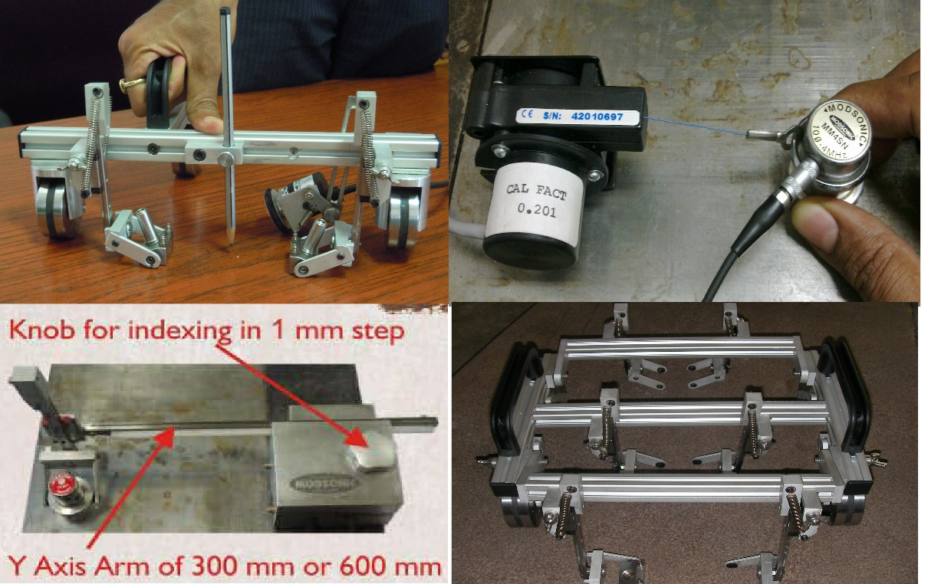
Our Portfolio of other Ultrasonic Testing Equipment :
Single and Dual Axis scanners
TOFD and Phased array scanners
Scanner with String Encoder.
Scanners and Encoders

Slide 55
Thank You.
www.modsonic.com

